Slide 1
INDIA
A Land of Thousand Opportunities
A Joint Presentation by
Protech India Ltd and Protech Italia in collaboration with
AIME, Italy, Provex, Italy, Camera Di Commercio Di Varese and Banca Di Credito Cooperativo e Fidi Altitalia

Slide 2
ARE WE TRYING
TO ESTABLISH INDIA AS THE BEST INVESTMENT DESTINATION IN THIS SEMINAR?
NO
Protech

Slide 3
THEN WHY ARE WE HERE?
Protech

Slide 4
ARE ITALIAN COMPANIES AT A CROSS ROAD?
AND
AND ARE WONDERING…..
WHAT NEXT?
Protech

Slide 5
DO YOU HAVE CERTAIN STRENGTHS WHICH YOU ARE NOT AWARE OF?
OR
IF AWARE, YOU JUST DON’T KNOW HOW TO MAKE USE OF IT
Protech

Slide 6
HAS INDIA MISSED THE BUS AND ARE CONDEMNED TO CRAWL SLOWLY
AND
PAINFULLY TOWARDS THE GOAL OF BEING A DEVELOPED NATION?
Protech
Protech

Slide 7
DO WE HAVE STRENGTHS AS NATIONS WHICH ARE COMPLIMENTARY?
Protech

Slide 8
ITALY’S STRENGTH | INDIA’S STRENGTH
Manufacturing knowhow | Strong industrial history
Design and innovation | Large workforce with adequate skills and competitive wage cost
Research and Development | Skilled Engineers and Technicians
Global market access | Large domestic market
Brand building | Decent capital mobilization market
Protech

Slide 9
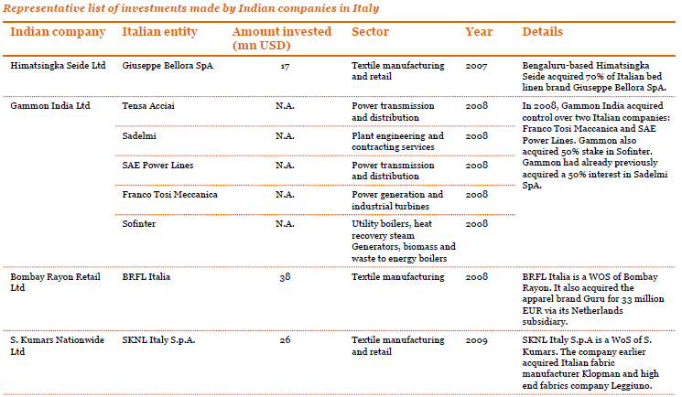
INVESTMENTS BY INDIAN COMPANIES IN ITALY
Protech

Slide 10
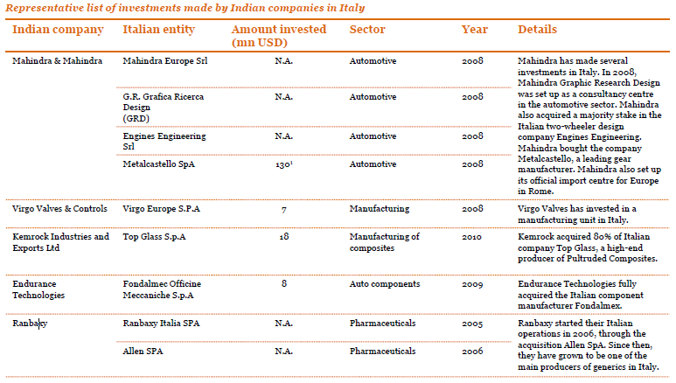
INVESTMENTS BY INDIAN COMPANIES IN ITALY
Protech

Slide 11
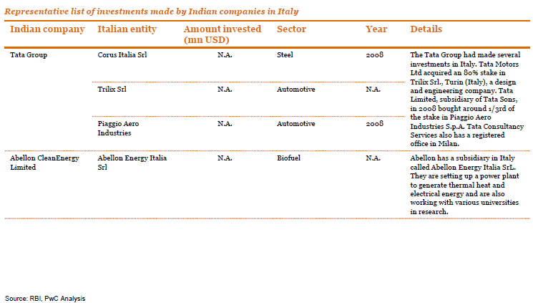
INVESTMENTS BY INDIAN COMPANIES IN ITALY
Source: Reserve Bank of India
Protech

Slide 12
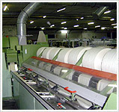
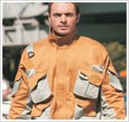
A FEW SUCCESS STORIES OF INDIAN COMPANIES INVESTING IN ITALY
LOYAL TEXTILES
A six decade old well established textile group
A vertically integrated company which is into ginning, spinning, weaving, knitting, finishing and garmenting of textiles
Joint Venture with Gruppo P&P SpA, Italy for manufacture of protective wear garments
The Joint venture company manufactures around 2.5 mn pieces per year
Loyal Group has a 51% share holding in the company
Protech

Slide 13
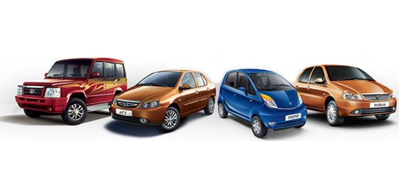
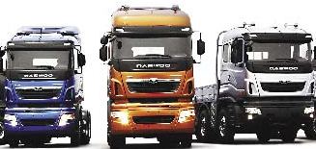
A FEW SUCCESS STORIES OF INDIAN COMPANIES INVESTING IN ITALY
TATA MOTORS
One of the largest business houses of India
Tata Group is into steel, automobiles, tea, IT, chemicals, consumer goods, materials, defence etc
Acquired 80% equity stake in Trilix Srl, Italy for Euro 1.85 mn.
20% of the stake is held by the promoters of Trilix Srl, Federico Muzio and Justyn Norek
Trilix Srl is into design and engineering services to the automobile industry
Though a small deal in terms of size, the acquisition has enhanced the designing capabilities of the Tata Motors
Protech

Slide 14

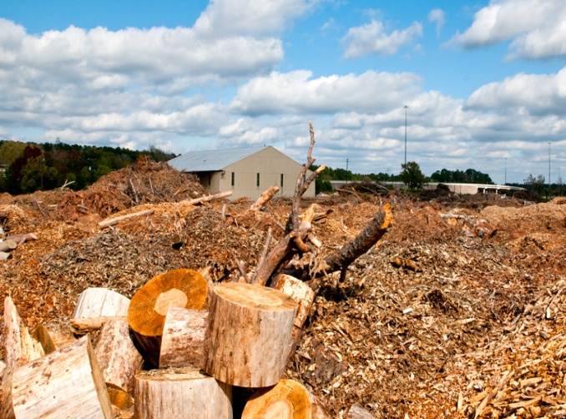
A FEW SUCCESS STORIES OF INDIAN COMPANIES INVESTING IN ITALY
ABELLON ENERGY ITALY Srl
The parent company was established in the year 2003
The company deals is a clean and sustainable energy solution provider through bio energy including solid and liquid bio fuels, bio power etc
Abellon Energy Italy Srl is wholly owned subsidiary company was founded in year 2009
The company is into clean energy projects for reducing carbon dioxide emissions and development of bio mass power projects
Protech

Slide 15
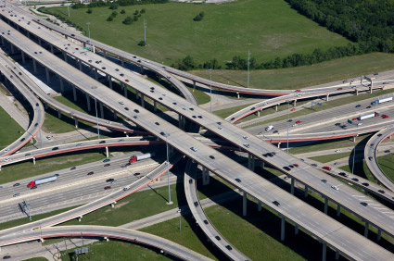
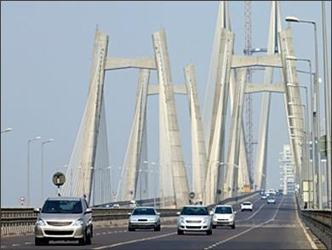
FAILURE STORY OF AN INDIAN COMPANY INVESTING IN ITALY
GAMMON INDIA LTD
Gammon India is one of the largest infrastructure construction company in India dealing in EPC contracts
They have presence in all sectors of civil engineering and design
The company entered into a technical collaboration with Cidade Tensacciai Srl Italy for execution of EPC contracts
The company is now disinvesting its non core business and disposing off its idle equipment
Reasons for failure have been given as:
  Weak order booking
  Paucity of working capital
  Weakening of Euro against the Dollar
  Uncertain political climate
Protech

Slide 16
INDO – ITALIAN TRADE
Protech

Slide 17
ITALY’S SHARE IN TOTAL IMPORTS OF INDIA
Figures in $ million
ITEMS | ITALY'S EXPORT TO INDIA |  | INDIA'S GLOBAL IMPORT |  | ITALY’S SHARE (%)
 | 2012 - 13 | 2013 - 14 | 2012 - 13 | 2013 - 14 | 2012 - 13 | 2013 - 14
MACHINERY | 2177.0 | 1832.0 | 65054.0 | 59821.0 | 3.3 | 3.1
CHEMICALS | 229.6 | 216.0 | 5282.8 | 4796.5 | 4.3 | 4.5
AUTOMOBILE SPARES | 113.7 | 113.9 | 4923.3 | 4475.7 | 2.3 | 2.5
PHARMACEUTICALS | 88.1 | 87.0 | 1747.6 | 1553.6 | 5.0 | 5.6
PLASTICS | 132.5 | 148.9 | 9611.1 | 10104.2 | 1.4 | 1.5
IRON & STEEL / PRODUCTS | 320.5 | 265.7 | 17716.0 | 12704.0 | 1.8 | 2.1
OPTICALS / PHOTOGRAPHIC INSTRUMENTS & PARTS | 125.3 | 119.8 | 6832.1 | 6722.5 | 1.8 | 1.8
PAPER / PAPER BOARD & ARTICLES | 49.1 | 99.1 | 1285.2 | 1385.2 | 3.8 | 7.2
Protech

Slide 18
ARE ITALIAN COMPANIES EXPORTING ENOUGH TO INDIA?
Protech

Slide 19
SOME PRODUCTS WHERE ITALIAN COMPANIES CAN INCREASE THEIR TRADE
MAIN ITEMS IMPORTED FROM ITALY BY INDIA
Machinery and capital goods
Electrical equipment
Precision and other machine tools
Metallurgical products
Iron and steel laminates
Chemicals
Pharmaceutical products
Engineering items
Medium oil and gas oil
Source: Ministry of Commerce and Industry
Protech

Slide 20
IS ITALY REALIZING THE POTENTIAL OF INDIAN TOURISM?
Protech

Slide 21
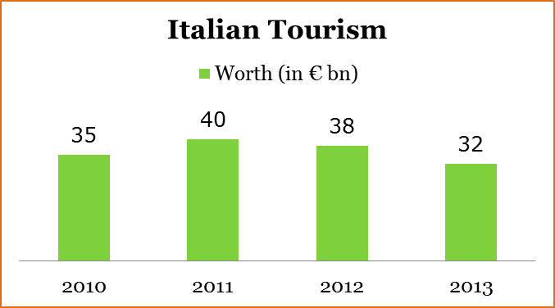
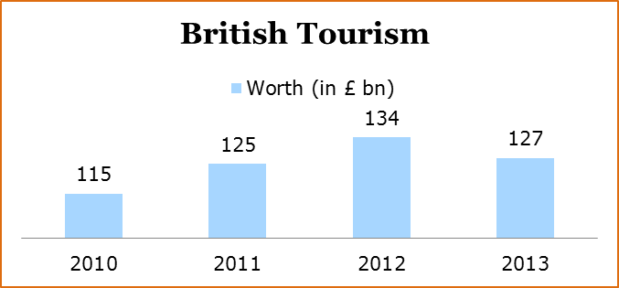
ITALIAN TOURISM INDUSTRY IN COMPARISON WITH OTHER COUNTRIES
Italy has a vast cultural heritage that can attract more tourism than most of the European countries.
Like most other European countries, Italy should also advertise about their country to attract global tourists with special focus on India
The British tourism industry is expected to grow to Euro 358 bn by 2025
Protech

Slide 22
GLOBAL TOURISM INDUSTRY
The German tourism industry is expected to grow to Euro 156 bn by 2025
The French tourism industry is expected to grow to Euro 245 bn by 2025
Protech
Notes:
http://www.tourismalliance.com/downloads/TA_365_390.pdf
http://tourismalliance.com/downloads/TA_353_377.pdf
http://www.tourismalliance.com/downloads/TA_327_353.pdf
file:///C:/Users/Abc/Downloads/france2014.pdf

Slide 23
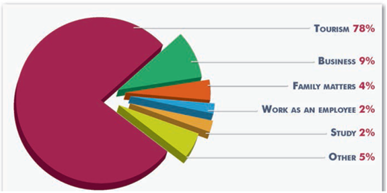
INDIAN TOURISM
PURPOSE OF VISITING ITALY
Total outbound Indian tourists in 2013 – 16.63 million, it’s about 1% of the total population.
Annual growth rate of outbound Indian tourist 11.4%
No. of Indian visited Italy: 276,497 in 2013
India stands 4th. in the list of entry visas issued
Protech

Slide 24
OUT BOUND INDIAN TOURISM
OUTBOUND INDIAN TOURISTS
Figures in million
COUNTRIES | 2011 | 2012 | 2013
ITALY | 0.19 | 0.25 | 0.29
SWITZERLAND | 0.20 | 0.22 | 0.25
UNITED KINGDOM | 0.36 | 0.34 | 0.39
Source: Ministry of Tourism
Protech

Slide 25




MOVIES AS A TOOL OF MODERN TOURIST MARKETING
MOVIE TOURISM
India film industry is largest in the world with over 1000 movies made every year. The industry is projected to grow from Euro 3 billion in 2010 to Euro 4.8 billion by 2015
Since a popular Bollywood movie ‘Zindagi Na Milegi Dobara’ (You won’t get another life) was mostly shot in Spain, there has been a sharp increase in arrivals from India into Spain.
In 2012 around 60,000 Indian tourists visited Spain which was 50 per cent more in comparison to the previous year.
Spain Tourism plans to spend around €100 million on its promotional and marketing activities to popularise the destination among Indians.
Protech

Slide 26
INDIA - AN EXCELLENT INVESTMENT DESTINATION FOR COMPANIES
WITH
SUFFICIENT MANAGEMENT BANDWIDTH
AND
FINANCIAL RESOURCES
Protech

Slide 27
INVESTMENTS BY ITALIAN COMPANIES IN INDIA
Selected leading Italian industrial and business groups already established and operating in India
Fiat (including New Holland & Magneti) | Armani
Ferrero | Pirelli
Perfetti Van Melle | Artsana / Chicco
Piaggio | Oerlikon Grazizno
Prysmian | Brembo
Maire Tecnimont | OBS (Coin/Oviesse)
Techint | Bauli (cakes)
Luxottica | Finmeccania
Assicurazioni Generali | St Microelectronis
Daniel, Maccaferri | Snamprogetti
Natuzzi | Ansaldo Caldaie
Ermenegildo | Lavazza
Source: Department of Industrial Policy & Promotion
Protech

Slide 28
TECHNICAL COLLABORATIONS WITH INDIA
Countries | No. of Technical Collaborations | Percentage of total (since 1991)
USA | 1824 | 22.62
Germany | 1114 | 13.82
Japan | 879 | 10.90
UK | 872 | 10.82
Italy | 488 | 6.00
Italy ranks 5th in number of approved technical collaborations (488) in India, accounting for around 6% of the total
Protech

Slide 29
INDO ITALIAN JOINT VENTURE CASE STUDIES
BENETTON GROUP
GRAZIANO TRANSMISSION
SESA MSF PRIVATE LTD
PREFETTI VAN MELLE PVT. LTD
WAM GROUP
ASIA POWER PROJECTS LTD
SAME DEUTZ-FAHR
Protech

Slide 30






INTERVIEW WITH Mr. UMBERTO FAVARO
HEAD OF PRODUCTION
BENETTON INDIA PVT LTD
Protech

Slide 31


PROFILE OF BENETTON INDIA PVT LIMITED
PROFILE
Benetton entered the Indian market in 1991-92, as a 50:50 joint venture with the DCM Group
JV ended in 2004 with Benetton taking over 100% ownership of the company.
Brand UCB present across 250 stores across 50 cities in India.
Brand Sisley also launched in India in 2006
Manufacturing unit at Near Delhi. Sourcing is also done through contract manufacturing
The company employs more than 300 people directly while indirect employment is in excess of 5,000 people
Protech

Slide 32
BENETTON IN INDIA
KEY SUCCESS FACTORS
Flexible and adaptable merchandising strategy
Direct retail marketing initiatives
Training & development initiatives of middle management
Continued importance given by the parent company
Strong contribution of franchisee partners
Protech

Slide 33


SAME DEUTZ-FAHR INDIA
PROFILE
SAME Greaves Tractors Ltd was a 50-50 joint venture between SAME of Italy and Greaves Cotton Ltd. to manufacture tractors in Mumbai, Maharashtra, India
It was established in 2000 to initially manufacture 10,000 tractors annually, but in 2002, Greaves sold out to SAME, and the company was renamed SAME Deutz Fahr India, Ltd.
Has an employee strength of 500 people producing 18000 tractors and 25000 engines of a total area of 35 acres in Ranipet, Tamil Nadu
Their product range includes front-end dozer,
front-end loader, sugarcane thrasher, harvester,
top-mounted harvest compressor and infielder.
Protech

Slide 34
SAME DEUTZ-FAHR INDIA
KEY SUCCESS FACTORS
They are the sole manufacturers of tractors and engines in Raiphet, Tamil Nadu.
They have 100 dealers
Their turnover in 2014 was €187.5 mn
Selling over 60000 units globally, with India being the top market accounting more than 35% of the sales
Targeting to achieve 90% market share in India by providing cutting edge technology present in higher ranged tractors.
Long term goal is to penetrate Indian market by providing India centric tractors as well as sustain a growth momentum in exports.
Protech

Slide 35


SESA S.P.A
PROFILE
Started in 1950, SESA SpA is a leading company from Italy in the area of manufacturing press plates for laminates producers
Manufactures high quality press plates for structures and finishes for high and low pressure laminates
Press plates are produced in various finsihes such as:
  Non-directional finsihes - Matt & Mirror
  Engraved finishes- Pearl, Ashwood, Uniwood
Has manufacturing, sales amd maketing
operations all over the world
Protech

Slide 36
SESA S.P.A
KEY SUCCESS FACTORS
Indian partner played the role to took charge of the day to day work
Italian partner was involved in technical guidance and direction
Clear division of responsibilities between the Italian and Indian partners
Availability of good quality technicians which can be further trained for the job at low labor cost
Protech

Slide 37
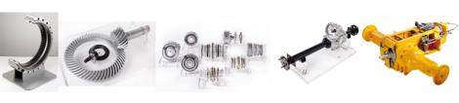

GRAZIANO TRANSMISSIONI
PROFILE
Entered India in 1998 as 100% subsidiary with a manufacturing unit in Noida, India, a place close to Delhi.
Unit was set up as 100% Export Oriented Unit. Has made an exit from EOU scheme after completing 10 years of operation. Unit now operates as a unit under Domestic Tariff Area ( DTA).
Products being manufactured in India include gears, shafts, synchronizers assembly and transaxle assembly.
Presently employee strength- 100
Protech

Slide 38
GRAZIANO TRANSMISSIONI
KEY SUCCESS FACTORS
Customer Acquisition: focused on small orders and concentrated on exceeding customer expectations, which then lead to larger orders and repeat business
Chose to supply wide variety of products with relatively smaller batch size to a number of OEM
Strategy for large number of customers to diversify market risks
Selected and sent 15 people to Italy for training for one year before the plant setting up of the pant and start of business operation
Indian business fully managed by Indian professionals trained in Italy
Protech

Slide 39
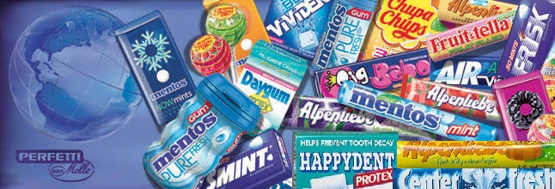

PERFETTI VAN MELLE INDIA
PROFILE
Perfetti started operations in India in 1994 as Perfetti India Ltd.
Presently it has close to 30% market share of the Indian market
Network of around 45,000 distributors in 2,000 urban towns
Brands present in India
  Center Fresh
  Big Babol
  Alpenliebe
  Chlormint
  Mentos
  Fruittella
  Cofitos,
  Happydent
Protech

Slide 40
PERFETTI VAN MELLE INDIA
KEY SUCCESS FACTORS
Cost competitiveness with low selling price
Launched brands after considerable market research so as to have insight about the likes and preferences of Indian consumers
The climatic conditions of the Indian geographical region have been kept under consideration for product composition and long shelf life
Aggressive sales strategy with a wide network of Carry & Forwarding agents (C&FA), distributors & sales force
10 to 15% of net sales each year is spent on advertising
Protech

Slide 41
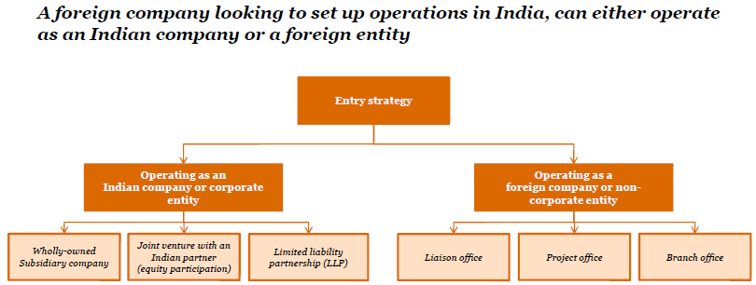
ENTRY STRATEGY FOR ITALIAN COMPANIES
Options to enter India
Protech

Slide 42
MODES OF OPERATION OF ITALIAN COMPANIES
Source: Embassy of Italy in India
Protech

Slide 43
MAIN SECTORS OF INTEREST FOR ITALIAN COMPANIES
Protech

Slide 44
MAJOR INDUSTRIES IN INDIA - SIZE AND GROWTH RATE
INDUSTRY | PRESENT MARKET SIZE | GROWTH RATE (%)
Textiles | 49 bn Euro | 11
Bio Technology | 2.1 bn Euro | 23
Pharmaceuticals | 7.14 bn Euro | 12
Automobiles | 32 bn Euro | 20
Auto Components | 15.4 bn Euro | 18
Aviation | 51.53 mn passengers | 19
Information Technology | 61.67 bn Euro | 16
Cement | 136.51 mn tons | 11
Steel | 64.88 mn tons | 8
Food Processing Industry | 49 bn Euro | 10
Protech

Slide 45
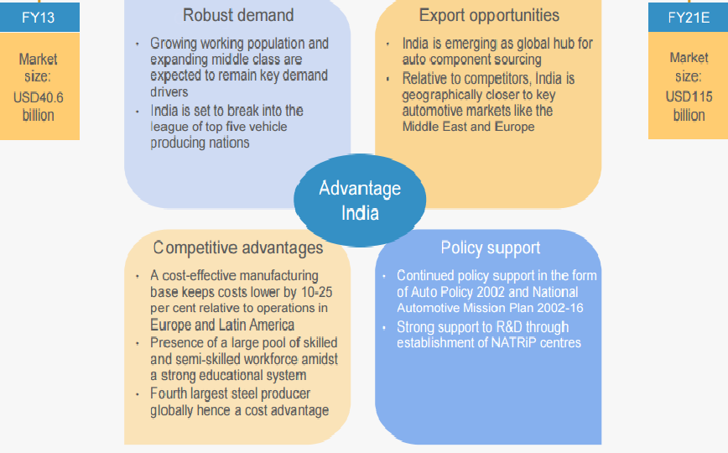
INDIAN AUTOMOBILE COMPONENT INDUSTRY
Protech

Slide 46
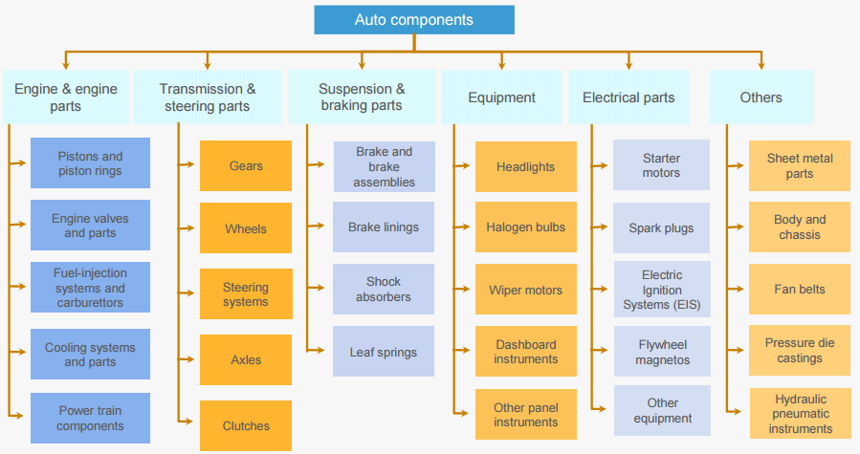
SEGMENTS OF THE AUTOMOBILE COMPONENT INDUSTRY WHERE ITALIAN COMPANIES CAN INVEST
Protech

Slide 47
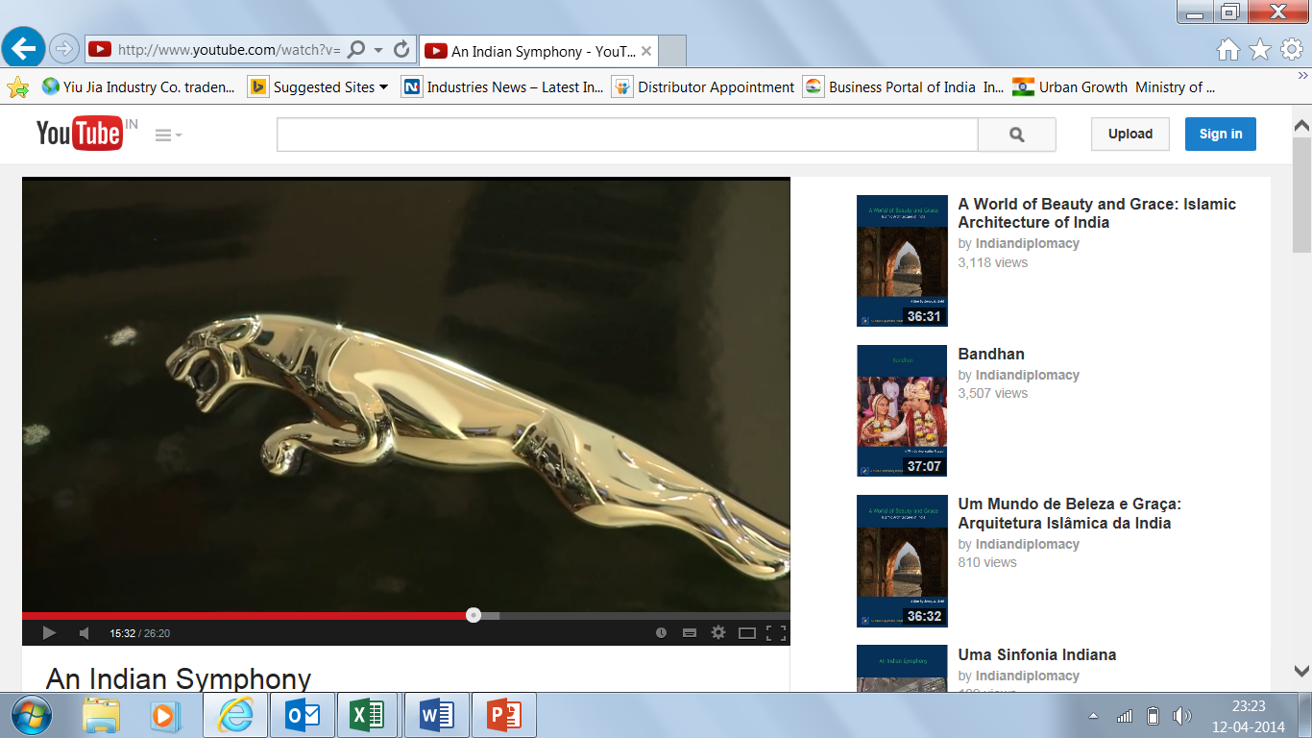
FDI INFLOW IN THE AUTOMOBILE INDSTRY
Key Foreign Players
Fiat (Italy)
Piaggio (Italy)
Ford (US)
Toyota (Japan)
BMW (Germany)
Honda (Japan)
Suzuki (Japan)
Hyundai (South Korea)
Nissan (Japan)
Mercedes (Germany)
Renault (France)
Volkswagen (Germany)
General Motors (US)
Audi (Germany)
Jaguar (UK)
Protech

Slide 48

INDIA INFRASTRUCTURE INDSTRY
Key Foreign Players
Maire Tecnimont (Italy)
AP Moller Maersk (Denmark)
Gaz De France (France)
Isolux Corsan (Spain)
IJM Corp (Malaysia)
Protech

Slide 49
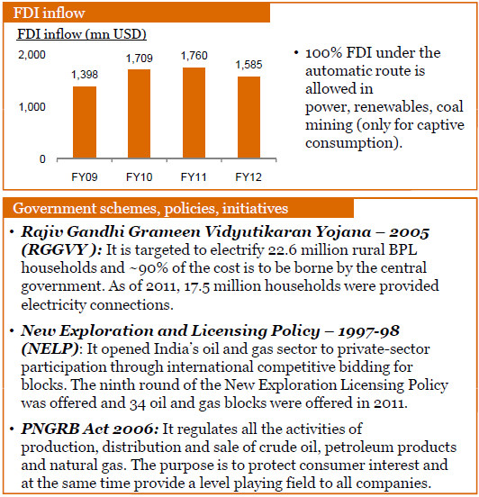

INDIA OIL AND GAS INDSTRY
Key Foreign Players
Shell (Netherland)
BP (UK)
BG Group (UK)
Carin (UK)
Protech

Slide 50
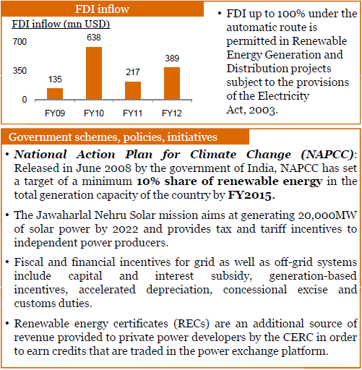

INDIA RENEWABLE ENERGY INDSTRY
Key Foreign Players
Solaria (USA)
Krempel Gmbh (Germany)
Siemens (Germany)
Vesta (Denmark)
Spitzen Energie Solutions (Germany)
Enercon (Germany)
Protech

Slide 51
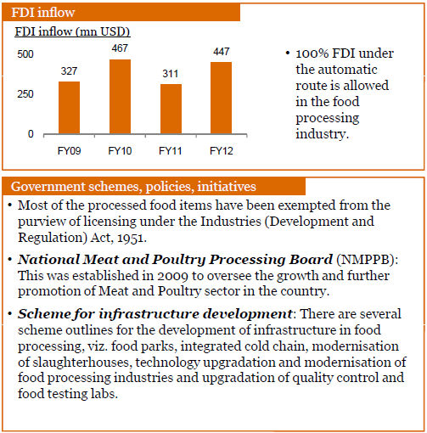

INDIA FOOD PROCESSING INDSTRY
Key foreign players
Nestle (Switzerland)
Kellogg (US)
Heinz (US)
Danone (Spain)
Mc Cain (Canada)
Agro Dutch Ind
Hatsun Agro Products Ltd
Protech

Slide 52
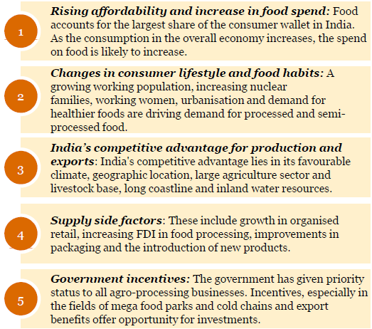
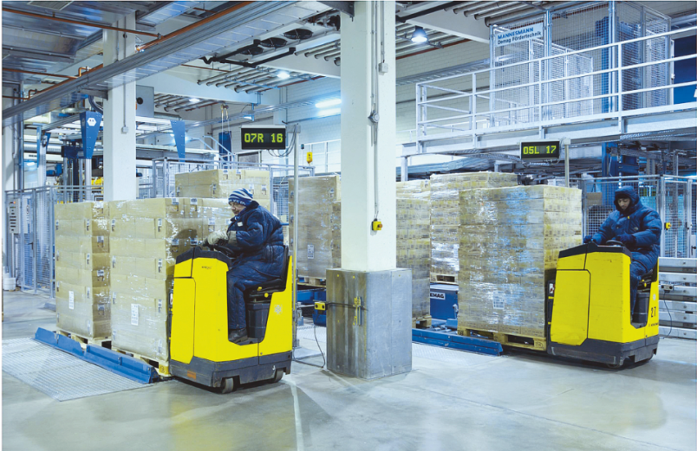
FOOD PROCESSING INDUSTRY - DEMAND DRIVERS
Opportunities for foreign players
Key foreign players
Twofold – Catering to the Indian market and making India an ‘outsourcing’ hub
Focus on improving supply chain infrastructure – cold storage, food parks and warehouses
Government offers incentives for supply chain infrastructure
Protech

Slide 53

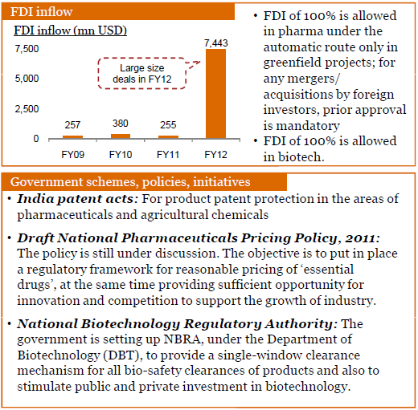
INDIA PHARMACEUTICAL INDSTRY
Key foreign players
GSK (UK)
Novo Nordisk (Denmark)
Merck & Co (US)
Astra Zeneca (UK)
H. Lundbeck (Denmark)
Sanofi-Aventis (France)
Novartis (Switzerland)
Abbot (UK)
Bayer (Germany)
Protech

Slide 54
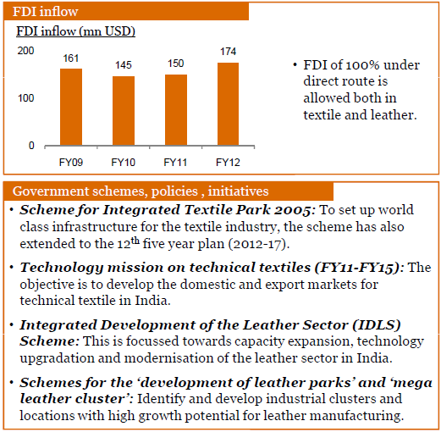
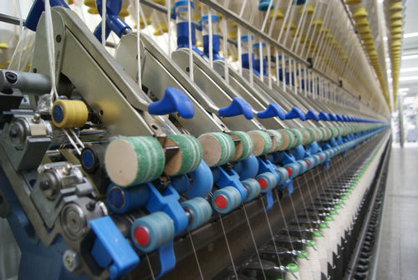
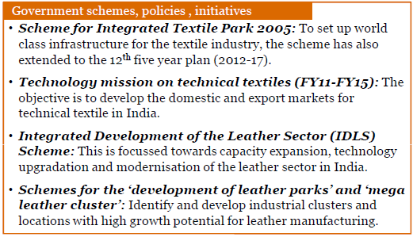
INDIA TEXTILE AND LEATHER INDSTRY
Key foreign players
Vulcabras Azalea (Brazil)
Tessitura Monti (Italy)
Soktas (Turkey)
Vincenzo Zucchi (Italy)
Bata (Switzerland)
Melvo (Germany)
OVS Industry (Italy)
Protech

Slide 55
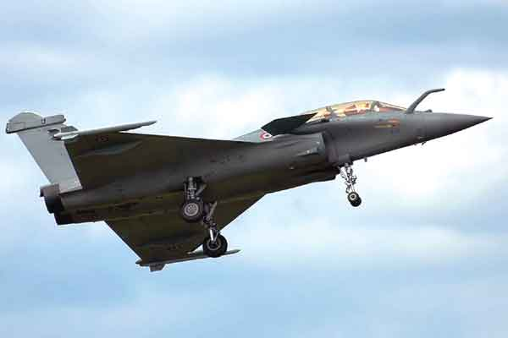
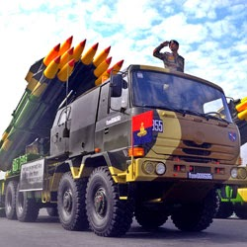
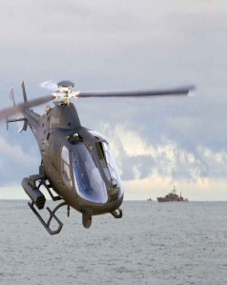
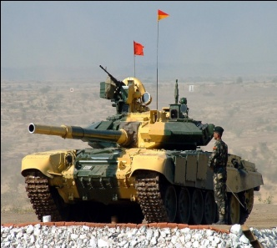
INDIAN DEFENCE INDSTRY
With an increase in the infringement of the Indian borders by Pakistan and China, Indian Government has laid a lot of stress in the ‘Make in India’ initiative for the defence sector
To encourage foreign participation the Government of India has increased the limit of Foreign Direct Investment to 49% subject to the Indian partner exercising management control
Recent development have seen that major Indian business groups like Ambanis, Tatas, Mahindra & Mahindra, Munjals etc entering the defence sector by going in for collaborations with foreign companies
Government schemes policies and initiatives

Slide 56
INDIA
AN OVERVIEW
Protech

Slide 57
SNAPSHOT INDIA
GDP € 1853 bn
Economic growth 7.4%
300 million upper middle class
E-commerce € 11.41 bn (2013)
930 mn cell phone subscribers
300 mn Internet subscribers

Slide 58
FDI INFLOW IN INDIA
Source: Reserve Bank of India
Protech

Slide 59
ITALIAN FDI IN INDIA
Of the total FDI inflow of US$ 34.3 bn in FY 2013 (April 2012–March 2013), Italy accounted for 0.49 % with a net investment of US $ 168 mn
As investments from other foreign nations increased, Italy has moved down one position (to rank 13th in FY 2012-13 compared to 12th in FY 2011-12) in the top investors ranking for India
Net annual FDI inflow from Italy to India (US$ mn) | % of total FDI in the year | Overall Rank
FY 2011-12 195 | 0.41% | 12
FY 2012-13 168 | 0.49% | 13
Italy is the fourth largest partner of India within EU27
Source: Reserve Bank of India
Protech

Slide 60
FDI INVESTMENT BY INDIAN COMPANIES GLOBALLY
All figures in US$ mn
Countries | Total | Share in total (%)
Netherlands | 8,427 | 28.8
Singapore | 4,454 | 15.2
British Virgin Islands | 3,687 | 12.6
Mauritius | 3,029 | 10.3
United States of America | 2,052 | 7.0
Italy ranks 32nd in the list, with an investment of US$ 32 mn
Protech

Slide 61
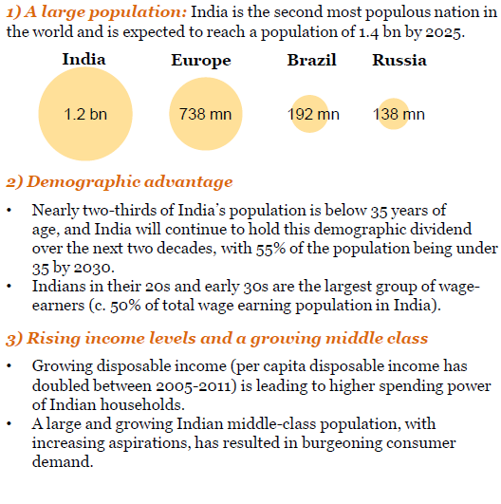
INDIA ADVANTAGE TO FOREIGN COMPANIES
India as a market
3) Rising income levels and a growing middle class
Growing disposable income (per capita disposable income has doubled between 2005-2014) is leading to higher spending power of Indian households.
A large and growing Indian middle-class population, with increasing aspirations, has resulted in increased consumer demand.
Protech

Slide 62
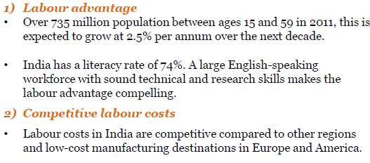
INDIA ADVANTAGE TO FOREIGN COMPANIES
India as a competitive marketing hub
Hourly wages for unskilled labor, 2014
 | 6
 |  |  |  |  | 5
 |  |  | 4
 |  |  |  |  |  |  |  |  | 3
 |  |  |  |  |  |  | 2
 |  |  |  |  |  |  |  |  |  |  | 1 |  | 1
 |  |  |  |  |  |  |  |  | Hungary |  | India |  | Mexico
Czech | Republic |  | Poland |  | Slovakia |  | Romania
Protech

Slide 63
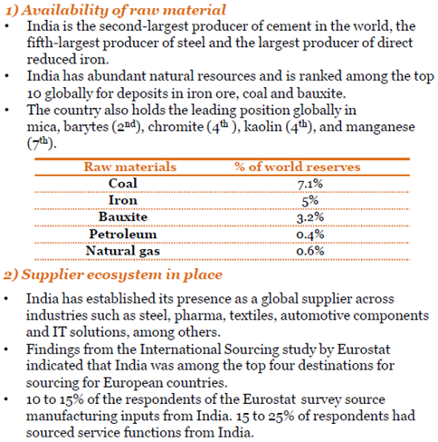
INDIA ADVANTAGE TO FOREIGN COMPANIES
India as a sourcing destination
Protech

Slide 64
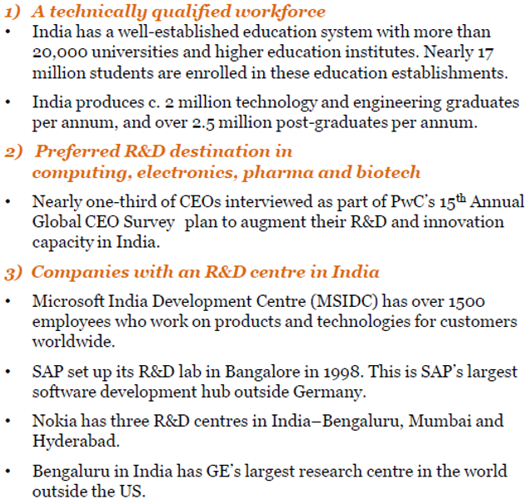
INDIA ADVANTAGE TO FOREIGN COMPANIES
India as a R & D Centre
Protech

Slide 65
EASE OF DOING BUSINESS IN INDIA
Policies and Incentives
Free repatriation of profits on capital investment is permitted
Use of foreign brand names/trademarks is permitted for sale of goods in India
Indian capital markets are open to FII’s
Indian companies are permitted to raise funds from international capital markets
‘Single window’ clearance facilities and ‘investor escort services’ are available in various states to simplify the approval process for new ventures
No requirement for a foreign partner to seek no-objection certificate from its Indian partner before starting a new business in the same field
Protech

Slide 66

REPATRIATION OF FOREIGN CAPITAL
Dividend
On profits and dividends earned in India are freely repatriable without any restrictions (net after tax deduction at source or Dividend Distribution Taxes as the case may be)
Interest
On Interest earned on fully, mandatorily and compulsorily convertible debentures is also freely repatriable without any restrictions (net of applicable taxes)
On sales proceed of shares
Allowed, subject to payment of applicable taxes
On winding up/liquidation
Allowed to remit winding up proceeds of companies in India, under liquidation or otherwise subject to payment of applicable taxes
Protech

Slide 67
COST OF DOING BUSINESS IN INDIA
COST OF LAND & UTILITIES
All figures in Euros
S. No. | LOCATION (STATE) | LAND COST / SQ. MTRS | WATER COST / KL | ELECTRICITY COST/ UNIT
1 | Gujarat | 10 - 25 | 0.20 – 0.30 | 0.09
2 | Maharashtra | 2.5 – 7.0 | 0.22 – 0.25 | 0.05
3 | Tamil Nadu | 5.9 – 11.5 | 0.30 – 0.38 | 0.10
4 | Karnataka | 3.2 – 9.5 | 0.13 – 0.20 | 0.13
Note:
The variation in the costs of the above depends on the development of infrastructure of a particular Industrial Estate
Protech

Slide 68
EXPENSES FOR SETTTING UP AN OFFICE IN MAJOR CITIES
All figures in Euros
S. No. | CITY | COST/SQ. MT. | RENTAL/SQ. MT.
1 | Delhi | 4300 - 7500 | 13 - 21
2 | Mumbai | 4300 – 7600 | 25 - 40
3 | Bangalore | 950 - 1370 | 5 - 7
4 | Chennai | 1350 - 1700 | 7 - 9
Note:
The cost and the rentals have been considered for A and A+ localities
Protech

Slide 69
SALARIES AND WAGE STRUCTURE
S. No. | CATEGORY | AVERAGE SALARY/MONTH IN EUROS
1 | Top Management (Foreign Repatriate) | 7000 - 8000
2 | Top Management (Indian) | 5000 - 6000
3 | Middle Management (Foreign Repatriate) | 4000 - 5000
4 | Middle Management (Indian) | 1500-1800
5 | Supervisors (Indian) | 300-320
6 | Skilled workers | 250-280
7 | Un-skilled workers | 180-200
Protech

Slide 70
RENTALS FOR RESIDENTIAL ACCOMODATION
All figures in Euros
S. No. | CITY | RENT /SQ. MT.
1 | Delhi | 6 - 9
2 | Mumbai | 15 - 30
3 | Bangalore | 4 - 6
4 | Chennai | 5 - 7
Note:
Rent has been taken for A and A+ localities
Protech

Slide 71
AVERAGE EXPENSES FOR RUNNING A HOUSEHOLD FOR A FOREIGN REPATRIATE
S. No. | Expense | Euro/Month
1 | Domestic help | 200
2 | Cook | 300
3 | Driver | 300
4 | School Fees | 1500
5 | Electricity | 300
6 | Conveyance | 500
7 | Household Expenses | 1600
 | Total | 4700
Note:
The above expenses have been calculated for a family of three persons
The above expenses have been taken for an employee in the top management. For employees in the mid management category, the expenses will be less by approximately 20 to 25%
Protech

Slide 72
TAX STRUCTURE
TAX DEDUCTION AT SOURCE (TDS)
PARTICULARS | TAX RATE FOR COMPANIES
Dividends | 10%
Interest Income | 10%
Royalties | 10%
Technical Services | 10%
Other income | 20%
Income from bonds, GDR’s or capital gains arising from their transfer | 10%
All companies incorporated in India are deemed as domestic Indian companies for tax purposes, even if owned by foreign companies.
Protech

Slide 73
CORPORATE INCOME TAX
PARTICULARS | CORPORATE TAX
A. Basic | 25%
SURCHARGE .. if net income exceeds Euro 147,730 … if net income exceeds Euro 1.47 mn | 7% for the AY 2016-17 12% for the AY 2016-17
TOTAL A | 25% + surcharge if applicable
B. Education Cess | 3%
TOTAL | Total A + B
1 Euro = Rs. 67.69
Protech

Slide 74
PERSONAL INCOME TAX
INCOME TAX SLABS | INCOME TAX RATES
Where total income does not exceed Euro 3693 | Nil
Where total income exceeds Euro 3693 but dos not exceed Euro 7386 | 10% of the amount by which it exceeds Euro 3693
Where total income exceeds Euro 7386 but does not exceed Euro 14,772 | 20% of the amount by which it exceeds Euro 7386
Where total income exceeds Euro 14,772 | 30% of the amount by which it exceeds Euro 14,772
Note:
The above rates are applicable for individuals below 60 years of age
1 Euro = Rs. 67.69
Protech

Slide 75
SERVICE TAX STRUCTURE
PARTICULARS | TAX RATE
Basic | 14%
Swachh Bharat Cess (2% of basic) | 2%
Total | 14.28%
Note:
Service Tax is applicable on more than 100 services.
Protech

Slide 76


INTRODUCTION – GRUPPO PROTECH
We are a South Asian consulting company with headquarters in New Delhi, India. We specialize in assisting international companies to plan and implement business strategies in making an entry into South Asia/Italy. Our activities include:
Effecting joint ventures
Mergers and Acquisitions (M&A)
Location Studies
Project feasibility studies
Manufacturing re-location
Market research studies
Project implementation services
Financial management services
Turnkey contracts
Supply chain management services etc.
We have been in the business of consultancy
for the past 22 years, having implemented
close to 30 joint venture projects, involving
a foreign company and an Indian company.
We have conducted over 50 market research
assignments
In Merger and Acquisition, we have to our credit
as a consultants, acquisitions made by our Indian
clients in Europe
Protech

Slide 77
PARTIAL LIST OF JOINT VENTURES
FACILITATED BY PROTECH INDA
A few of the joint venture deals we have concluded are:
Tessitura Monti India (P) Ltd, Kolhapur --- 100% owned by Tessitura Monti Spa, Italy --- yarn dyed shirting fabrics
Estenberg Consulting, Sweden --- Technical collaboration between Estenberg Consuting, Sweden and Godrej Interio for transfer of technical know how for sofa making
IRV Textiles SA, Portugal --- Joint Venture between IRV Textiles, Portugal and Loyal Textiles, Chennai for establishing a commercial joint venture company in Portugal for product development, soliciting business for Loyal Textiles factories in India and also doing orders requiring quick turnaround in Portugal, Morocco and Tunisia
Hanil Era Textiles Ltd, Patalganga, Maharashtra --- Joint venture between Hanil Synthetic Fiber Ltd, South Korea and New Era Fabrics Ltd, Mumbai---100% acrylic yarn, cotton-acrylic blended yarn and 100% cotton yarn
Protech

Slide 78
PARTIAL LIST OF JOINT VENTURES
FACILITATED BY PROTECH INDA
Tirumala Seunghan Ltd, Hyderabad --- Joint venture between Seunghan Corp, South Korea and Tirumala Textiles Ltd, Hyderabad---Acrylic mink blankets
Indocount Choongnam Textiles Ltd, Vadodhra, Gujarat --- Joint venture between Choongnam Spinning Co Ltd, South Korea and Indocount Industries Ltd, Kolhapur---100% cotton yarn and cotton-polyester yarn
Oswal Hammerle Fabrics Ltd, Kolhapur ---- Joint venture between Oswal Group, India and F. M. Hammerle, Austria --- yarn dyed shirting fabrics
Renfro India Ltd, Pune --- Joint venture between D.L. Hurwitz Intersocks Srl, Italy (100% owned by Renfro Inc., USA) and Karnik Enterprises, India —100% cotton socks
Vardhman Barbour Campbell Ltd, Baddi, Himachal Pradesh --- Joint venture between Vardhman Group, India and Barbour Campbell Ltd, UK --- Industrial sewing thread
Datt Medi Products Ltd, Roz Ka Meu, Haryana --- Technical and marketing collaboration between Datt Enterprises, India and Texpol, Spain --- medical textiles
Protech

Slide 79
PARTIAL LIST OF JOINT VENTURES
FACILITATED BY PROTECH INDA
Karan Woosin Ltd, Hyderabad, Andhra Pradesh---Joint venture between Woosin Corp, South Korea and Karan Textiles, Hyderabad----100% cotton, cotton-acrylic and 100% acrylic socks
Shamken Multifab Ltd, Kosi, UP---Technical collaboration between Iljeong, South Korea and Shamken Group, India----automotive fabrics
Saladino Continental Ltd----Joint venture between Calzificio Saladino, Italy and Continental Pumps Ltd, Ghaziabad----100% cotton socks
Attar Filte Ltd, Panipat --- Joint venture between Filte Spa, Italy and Attar Spinners Ltd, Panipat ---- knitted fabrics
KOB Medical Textiles (P) Ltd, Coimbatore --- 100% owned by Karl Otto Braun GmbH, Germany --- medical textiles
Protech

Slide 80
INDO- EUROPEAN M&A ALLIANCES FACILITATED BY US IN THE AREA OF TEXTILES
Acquisition of Mileta SA, Czech Republic by Alok Industries Ltd, India --- yarn dyed shirting fabrics, damask fabrics, table linen and handkerchief
Acquisition of IMM Spa, Italy by Winsome Group, India ---sweaters
Acquisition of RLS Trading, Slovakia, by Bang Overseas, India --- shirts
Protech

Slide 81
PARTIAL LIST OF MARKET RESEARCH ASSIGNMENTS CONDUCTED IN INDIA
All India market research have been done on the following industries:
Brake Shoes and Pads used in two wheelers
Ice Cream Industry
Ready to Assemble Furniture Market
Linen Yarn Industry
Synthetic Leather Industry
Spectacle Frames Industry
Packaging Industry – A multi client study
Paper Industry – A multi client study
Laminated Collapsible Tubes
Seamless Tubes
Stationery Products Industry
Indian Spinning Industry
Edible Oils Industry
Formaldehyde Industry
Re-cycled Fiber Industry
Cosmetic Industry
Household Furnishing and Floor Coverings Industry
Woven Synthetic Market
Processed Food Industry
Waste Paper Industry
Building Hardware Industry
Wire and Cable Industry
Protech

Slide 82
PARTIAL LIST OF INTERNATIONAL MARKET RESEARCH ASSIGNMENTS
Market Survey on European Home Textile Market
Market Survey on Shirting fabric in India, Sri Lanka and Bangladesh
Market Survey on Sweater manufacturing in India, Bangladesh and China
Market Survey on underwear and nightwear market in South Asia
A study of the Italian market for clothing
A study of the French market for clothing
A study of the German market for clothing
A study of the UK market for clothing
A study of the Austrian and Swiss market for clothing
A study of the Belgian and Dutch market for clothing
A study of the Finnish and Norwegian market for clothing
A study of the Spanish and Portuguese market for clothing
A study of the Vietnamese and Cambodian market fabric market
Protech

Slide 83
A FEW OF OUR MARKET RESEARCH ASSIGNMENTS CONDUCTED FOR GOVERNMENT OF INDIA
Preparation of Product Profiles for Readymade Garments for the Apparel Export Promotion Council -- Ministry of Commerce
International Study for Major Sports Goods & Equipments for the Export Promotion Council of India -- Ministry of Commerce
Indicative Medium Term Plan for Export Targets and Export Strategies (Sports Goods) -- Ministry of Commerce
The Study of Paper Industry in India -- Ministry of Commerce and Indian Agro Paper Mills Association
Protech

Slide 84
SOME OF OUR INTERNATIONAL CLIENTS
COCA COLA, USA
CITI BANK, USA
CADBURY, UK
SAMSUNG GROUP, KOREA
TOSHIBA CORPORATION, JAPAN
KARL OTTO BRAUN, GERMANY
CEBAL, USA
ITV, PORTUGAL
HANJIN GROUP, KOREA
CHOONGNAM SPINNING, KOREA
HANIL SYNTHETIC FIBRES, KOREA
DAEWOO CORPORATION, KOREA
ERC STATISTICS INTERNATIONAL, UK
INGHIRAMI GROUP, ITALY
SEYMOUR COOKE, UK
HYOSUNG GROUP, KOREA
MARUBENI CORPORATION, JAPAN
MITSUI & CO. LTD, JAPAN
Protech

Slide 85
SOME OF OUR INTERNATIONAL CLIENTS
MITSUBISHI GROUP, JAPAN
VF IMAGEWEAR, USA
SFERA BROS, USA
SARA LEE CORP. USA
HOWA CORPORATION, JAPAN
TEBE TEXTIL, PORTUGAL
ARCO TEXTILES, PORTUGAL
CHANRAI KEWAL RAM GROUP, SINGAPORE
VICENZO ZUCCHI SPA, ITALY
MIROGLIO GROUP, ITALY
TESTA SPA, ITALY
INGHIRAMI GROUP, ITALY
REDELLI VELLUTI, ITALY
GRUPPO ARCTE, ITALY
IMM SPA, ITALY
DMC GROUP, FRANCE
GRUPPO EMINENCE, FRANCE
Protech

Slide 86
SOME OF OUR INTERNATIONAL CLIENTS
GRUPPO FRANZONI, ITALY
GRUPPO GFT, ITALY
LONFIL SPA, ITALY
GRIGNASCO SPA, ITALY
TAIANA VIRGILIO SPA, ITALY
UTE , FRANCE
TALLEGNO 1900, ITALY
CAULLIEZ FRERES, FRANCE
TEXTIL SANTANDERINA, SPAIN
GRUPPO TAVEX, SPAIN
ORFAMA, PORTUGAL
RUSSELL CORP. USA
RAGNO, USA
HILOS IRIS, MEXICO
CANCLINI, ITALY
ENDUTEX, PORTUGAL
TVILLUM, DENMARK
Protech

Slide 87
SOME OF OUR INTERNATIONAL CLIENTS
BARBOUR CAMPBELL, UK
FILATURA DI GRIGNASCO SPA, ITALY
GREENLEE TEXTRON, USA
MARKET POWER, UK
IL JEONG, KOREA
IMES, UK
JAHNCKE, GERMANY
KYMEN SUKKA, FINLAND
MARPLAN, GERMANY
ORLANDI GROUP, ITALY
PANGRIM CO LTD, KOREA
RUBICON INTERNATIONAL, UK
SAMYANG CORPORATION, KOREA
Protech

Slide 88
GRUPPO PROTECH
Protech India Ltd
A-65, Sector-80
Noida Industrial Area Phase – II
NOIDA – 201 301
INDIA
Protech Italia/Camal Consulting
Via Costa 20
21013 Gallarate (VA)
ITALY
Protech

Slide 89
YOU HAVE WHAT WE DON’T
WE HAVE WHAT YOU DON’T
Protech

Slide 90
WHAT YOU HAVE
WORLD MARKET AT OUR DOOR
STEP
+
WHAT WE HAVE
=
Protech

Slide 91

Come to India!
Protech

Slide 92
THANK YOU
GRAZIE

